Slide 1
MATRIX Aljabar Linear
Shofwan Fikrul Huda (24060124130106)
Yasmina Syahidah (24060124130116)
Yustinus Hendi Setyawan (24060124130114)

Slide 2
Table of contents
01
02
03
04
OKE OBE Matrix
Matrix A dan B
Equivalen Matrix
Determinan Matrix
05
Rank Matrix

Slide 3
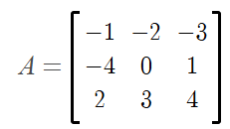
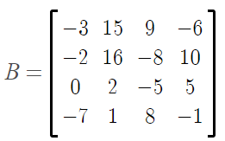
Matrix A dan B

Slide 4
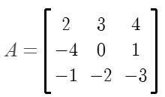
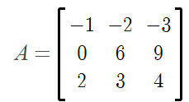
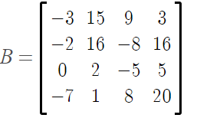
OKE OBE Matrix
H₁₃(A) =
H₂₍₁₎₃₍₂₎(A) =
K₄₁₍₋₃₎(B) =

Slide 5
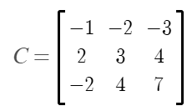
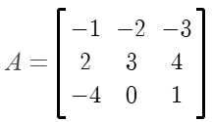
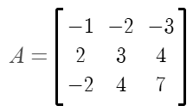
Equivalen Matrix
A~C
H₂₃(A)
H₃₍₁₎₁₍₋₂₎

Slide 6
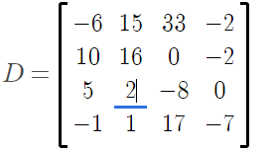
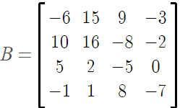
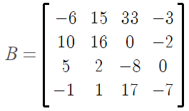
Equivalen Matrix
B~D
K₁₄(B)=
K₃₍₂₎₂₍₁₎(B)=

Slide 7
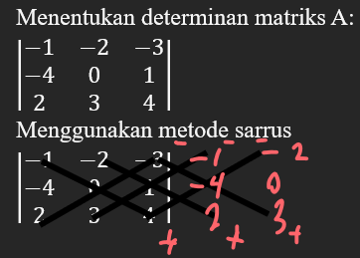
Determinan Matrix
(1×0×4) + (-2×1×2) + (-3×(-4)×3) – (2×0×(-3)) – (3×1×(-1)) – (4×(-4)×(-2) = (0-4+36-0+3-32) = 3

Slide 8

Determinan Matrix
$$B_{11}C_{11}{+ B}_{12}C_{12}+B_{13} C_{13}+B_{14}C_{14} \text{=}$$

Slide 9




Determinan Matrix
= 16(-35) – (-8)(-7) + 10(21) = -406
= -2(-7) – 16(35) – 10(14) = -406
= -2(-35) – (-8)(35) – 10(-35) = 0
= -2(21) – 16(-35) – (-8)(14) = 406
det (B) = -3(-406) – 15(0) + 9(-406) – 6(406) = 406×0 = 0

Slide 10
Rank Matrix
= Karena tidak bisa dicari lagi maka rank matrix A = 3

Slide 11
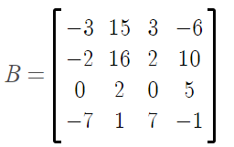
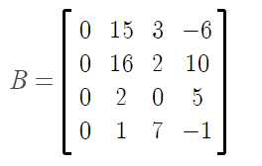
Rank Matrix
B₃₍₁₎₄₍₁₎
B₁₍₁₎₃₍₁₎
Maka, rank matrix B = 3

Slide 12
Thanks!

